Slide 1
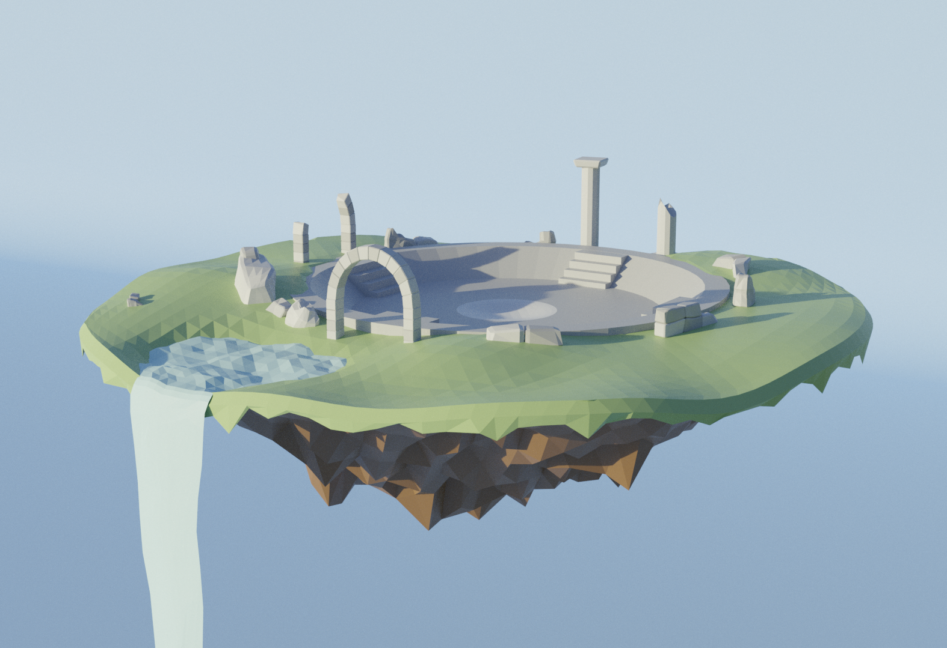
The Uncorrupted

Slide 2
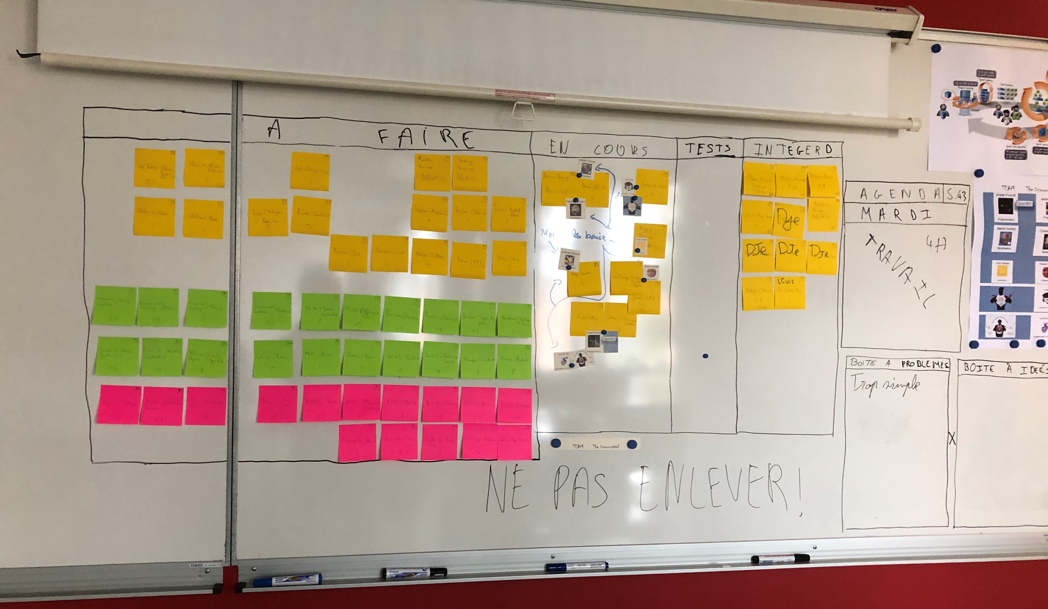
The Uncorrupted

Slide 3
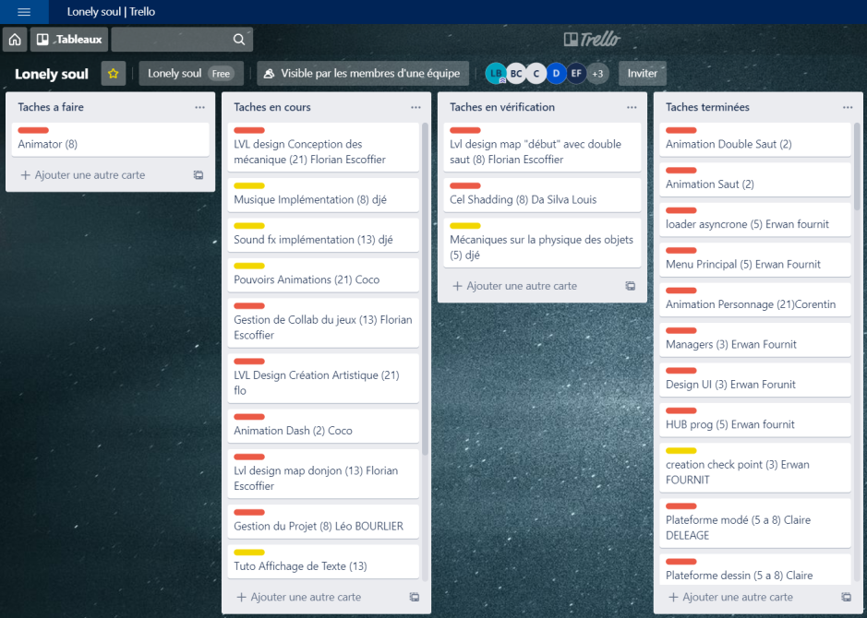
The Uncorrupted

Slide 4
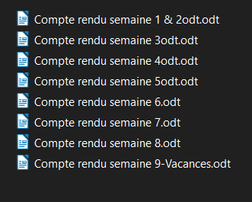
The Uncorrupted

Slide 5
The Uncorrupted

Slide 6
The Uncorrupted

Slide 7
The Uncorrupted

Slide 8
The Uncorrupted

Slide 9
The Uncorrupted

Slide 10
The Uncorrupted

Slide 11
The Uncorrupted

